Slide 1
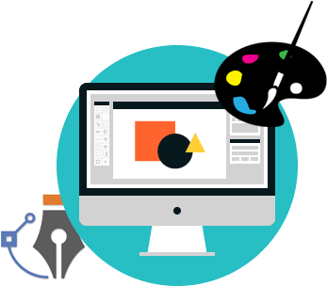
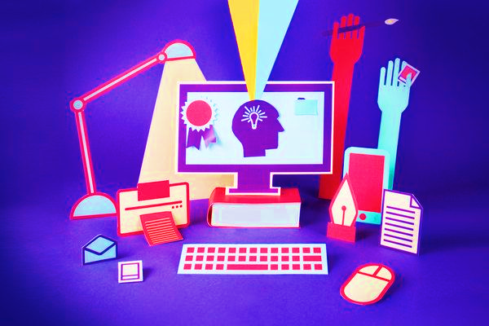
Impacts of computer in daily life
Computers are commonly used device in many areas. It is an important system for people , especially the people who run organizations, industry, etc. Almost all the things we know is made by or run by computers.

Slide 2
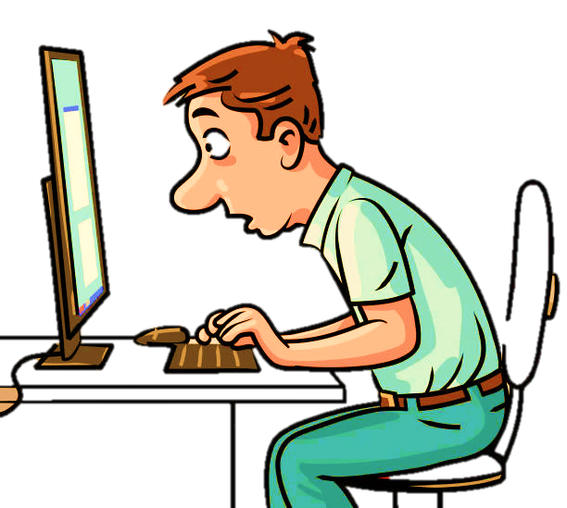


Learn
Impacts of computer in daily life
NEGATIVE IMPACTS
POSITIVE IMPACTS

Slide 3







Positive impacts of computer
Positive impacts of computer
Helps to learn new things.
Learn
Keeps us connected.
Saves our time.
Helps to organize data.
POSITIVE IMPACTS
Keeps us entertained.

Slide 4


Helps to learn new things!
Gives instant information on any topic in just a single click.
We can learn a new profession by reading websites or watching videos.
We can access worldwide news to keep up-to-date with all of the latest news.
Learn
EDUCATION
Learn

Slide 5
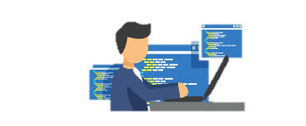
Keeps us connected
Computers help keep you connected with long-distance friends and family over e-mail and social networking .
We can connect with millions of other people who share their interest through social media apps.
Computers helped the Business industry to communicate with people on the other side of the globe without traveling.
Learn
EDUCATION
Connect

Slide 6

Helps to save time
We can easily use an online banking site to view our bank balance and pay bills.
We can order almost everything in just a second without going outside of the home.
We can automate the business and other activities using computer and save our time.
Learn
EDUCATION
Save Time

Slide 7
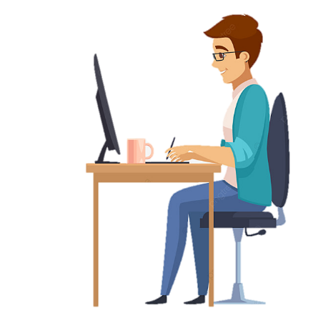
Helps to organize data
With the help of computer we can easily organize our daily schedule.
We can organize our Business’s data like which product are selling and which are not.
We can organize our projects and documentation.
EDUCATION
Organize

Slide 8
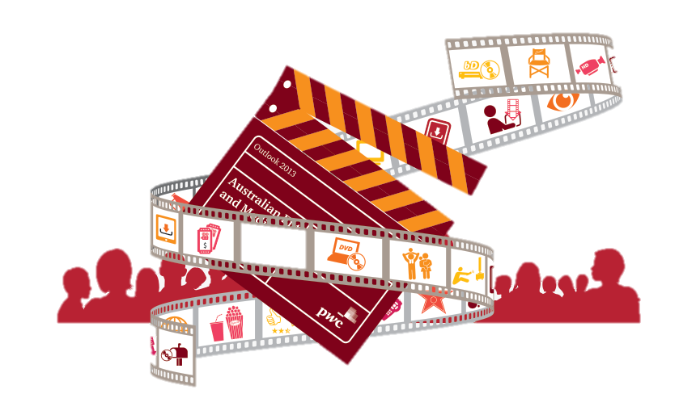
Keeps us entertained
With a computer, we can store and listen to millions of songs.
We can watch a thousands of movie to entertain ourselves.
We can watch an endless amount of streaming and online videos from popular sites.
EDUCATION
Entertain

Slide 9

Negative impacts of computer
Affects the physical health.
Changes the Academic performance
Lessens the social interactions

Slide 10

Affects on Physical health
Poor eye sight.
Weight gain or loss.
Back and hand pains.
Learn
EDUCATION
Learn

Slide 11
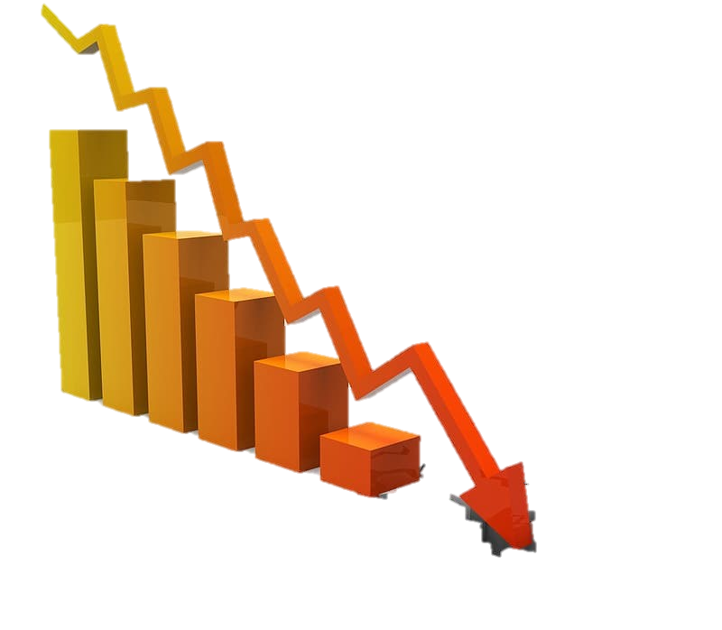
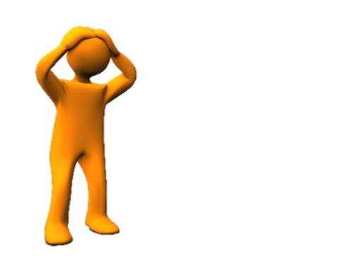
Changes the Academic performance
Having trouble in completing projects and home works.
Failing grades.
Not able to give attention to studies.
Learn
EDUCATION
Learn

Slide 12
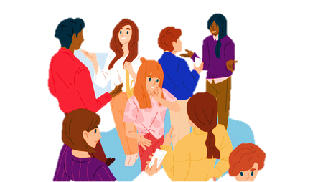
Lessens the social interactions
Isolation from family and friends.
Afraid to talk with other people.
Don’t want to stay in public places.
Learn
EDUCATION
Learn

Slide 13
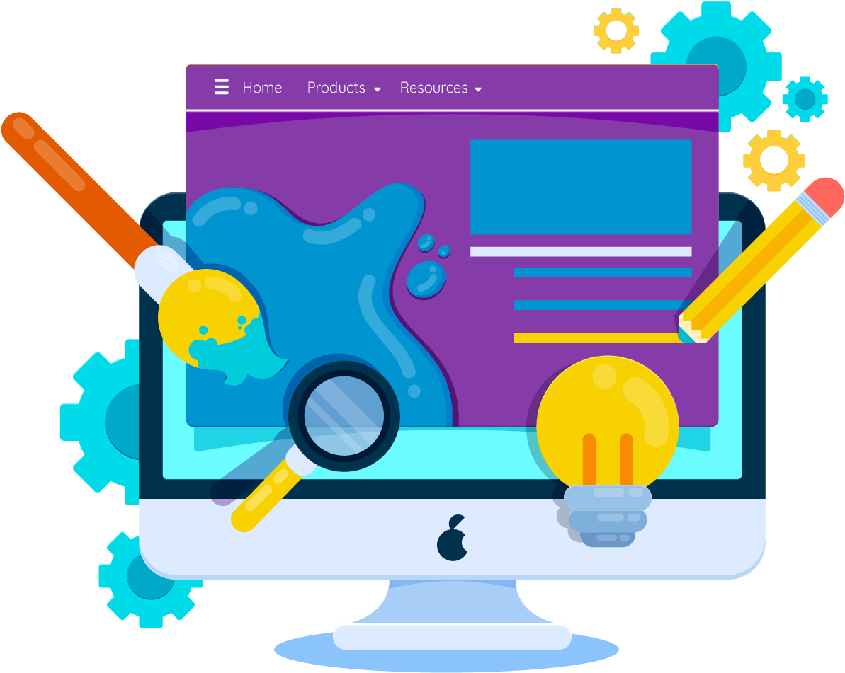
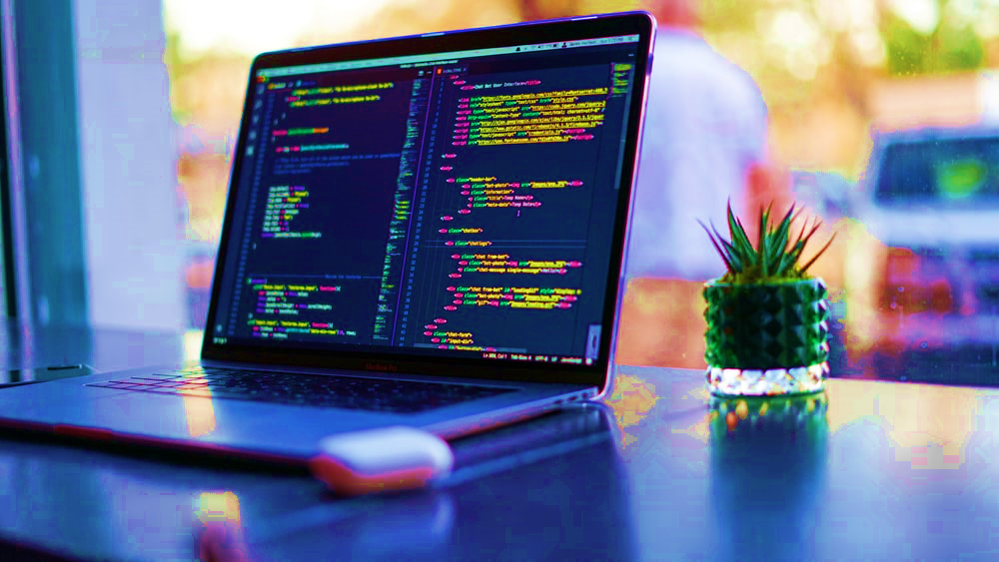
Thank you
For watching
Presented by: Bishal Sunar

